Slide 1
Community Service Project
Process Journal

Slide 2
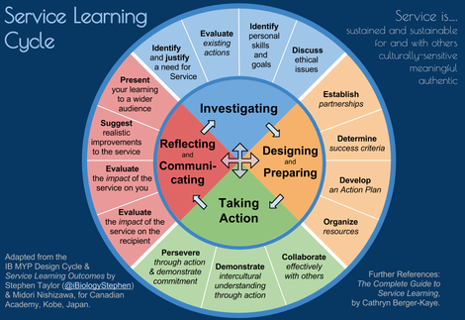
What are we doing?

Slide 3
The process Journal
What it IS!
  - used throughout the project to document its development
  - an evolving record of intents, processes, accomplishments
  ​- a place to record initial thoughts and developments, brainstorming, possible lines of inquiry and further questions raised
  - a place for recording interactions with sources, for example teachers, supervisors, external contributors
  - a place to record selected, annotated and/or edited research and to maintain a bibliography
  - a place for storing useful information, for example quotations, pictures, ideas, photographs
  - a means of exploring ideas and solutions
  - a place for evaluating work completed
  - a place for reflecting on learning
  - devised by the student in a format that suits his or her needs
  ​- a record of reflections and formative feedback received.

Slide 4
The process Journal
What it is NOT!
- used on a daily basis (unless this is useful for the student)
- written up after the process has been completed
- additional work on top of the project: it is part of and supports the project
- a diary with detailed writing about what was done
- a static document with only one format

Slide 5
Evidence – What can I use for evidence?
- bulleted lists
- charts
- short paragraphs
- notes
- timelines, action plans
- annotated illustrations
- annotated research
- artifacts from inspirational visits to museums, performances, galleries
- pictures, photographs, sketches
- up to 30 seconds of visual or audio material
- screenshots of a blog or website
- self and peer assessment feedback

Slide 6
LCMA Webpage for the
Process Journal& Examples
Lets look at the webpage :)
  http://lcmacommunityproject.weebly.com/the-process-journal.html
Pictures of a type of process journal – Composition book
  http://lcmacommunityproject.weebly.com/pictures-of-2015-16-projects.html
Pictures of a type of process journal – Web Page
  http://ourlibraryproject.weebly.com/

Slide 7
How Do You Start?
Look at the Community Project Outline that has been provided for you
This outline provides all the information you will need to find in your completed process journal.
Be certain that as you progress through your project that you are referring back to this document
The 'handbook' is the 'project guide' and is located under IB Project Publications

Slide 8

Have Fun – Learn Something,
Make a Difference!
Click Picture

