Slide 1
Welcome to Ms. Gibson’s Class
2022-2023 - This will be a year to remember!

Slide 2
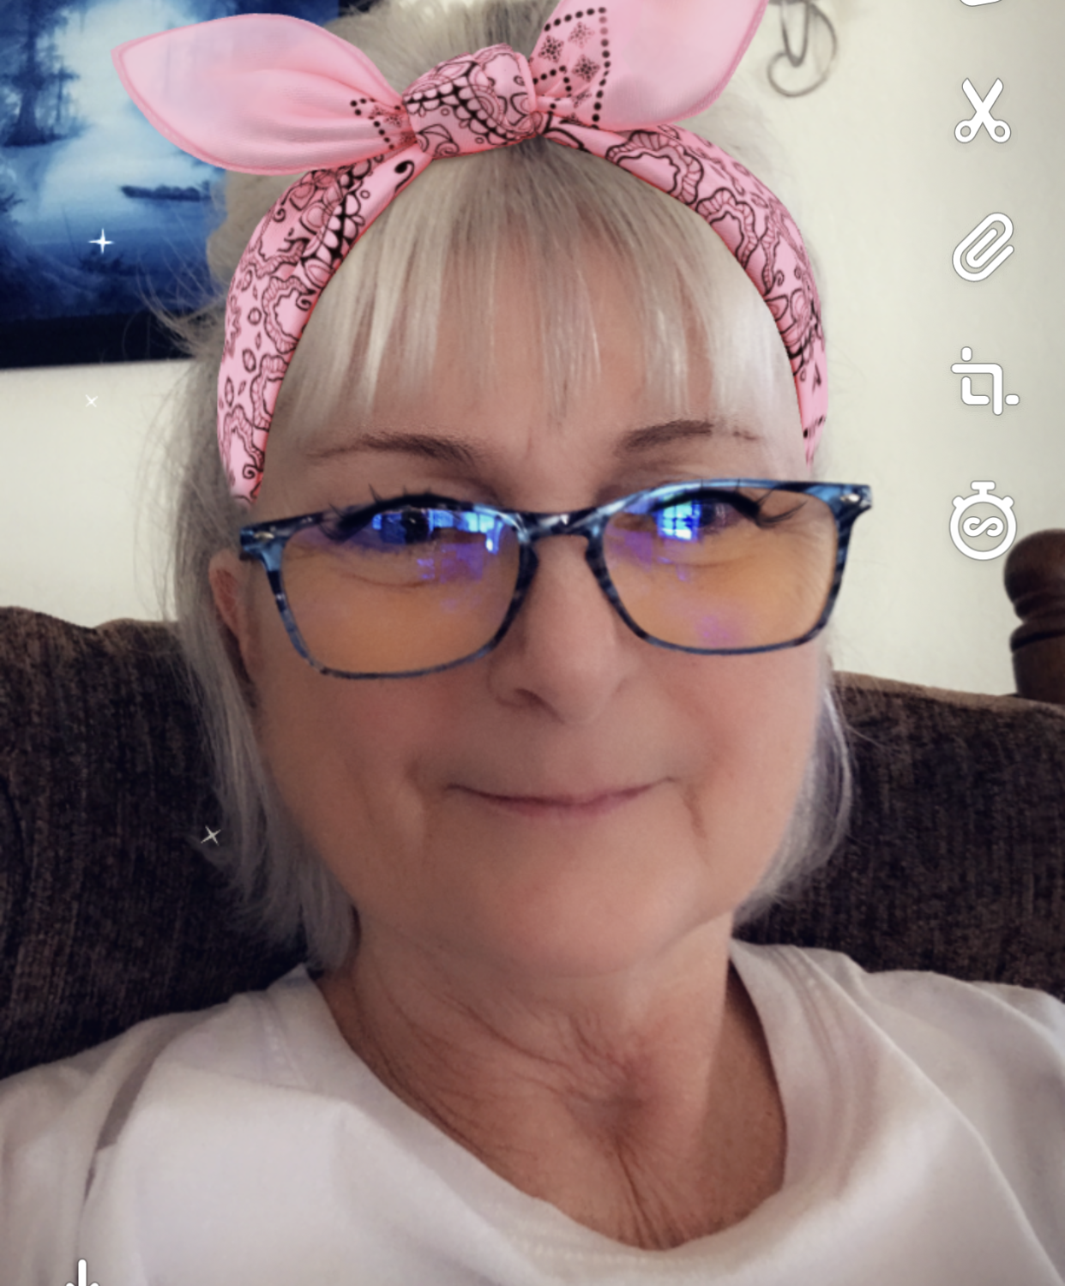
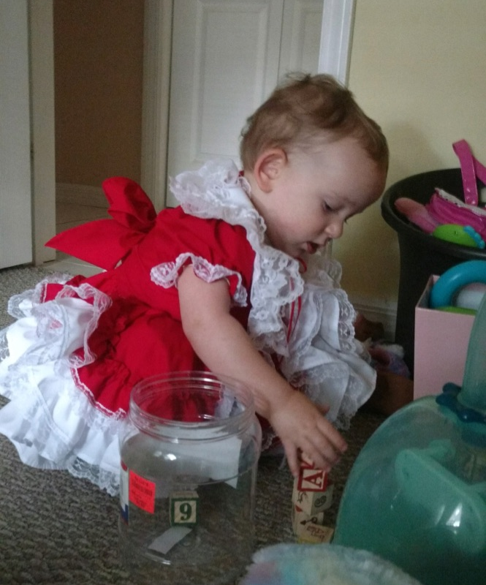
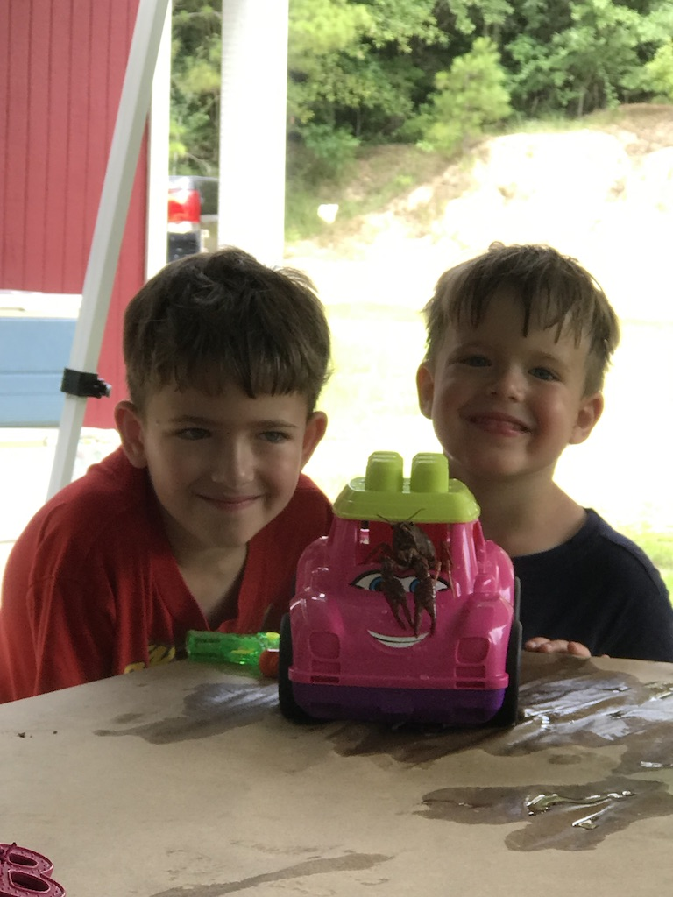
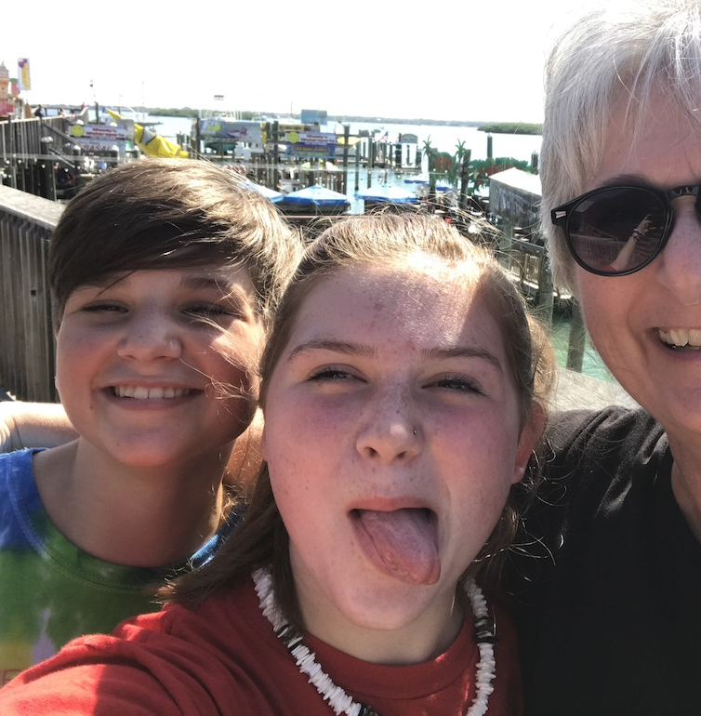
A Bit about Me
Education: AAS – Medical Technology, AAS – Meteorology, BS – Human Resources, MS– Cooperative Teaching and Learning
USAF Veteran – 22 years of service
Science Teacher – 16 years
Passions: Faith, Family, Exploring and Learning about people and the world around us

Slide 3
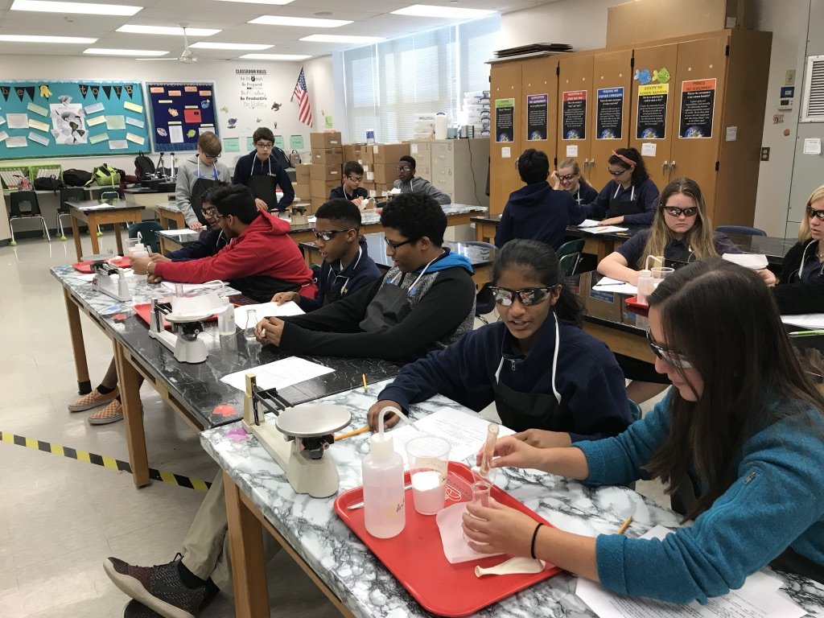
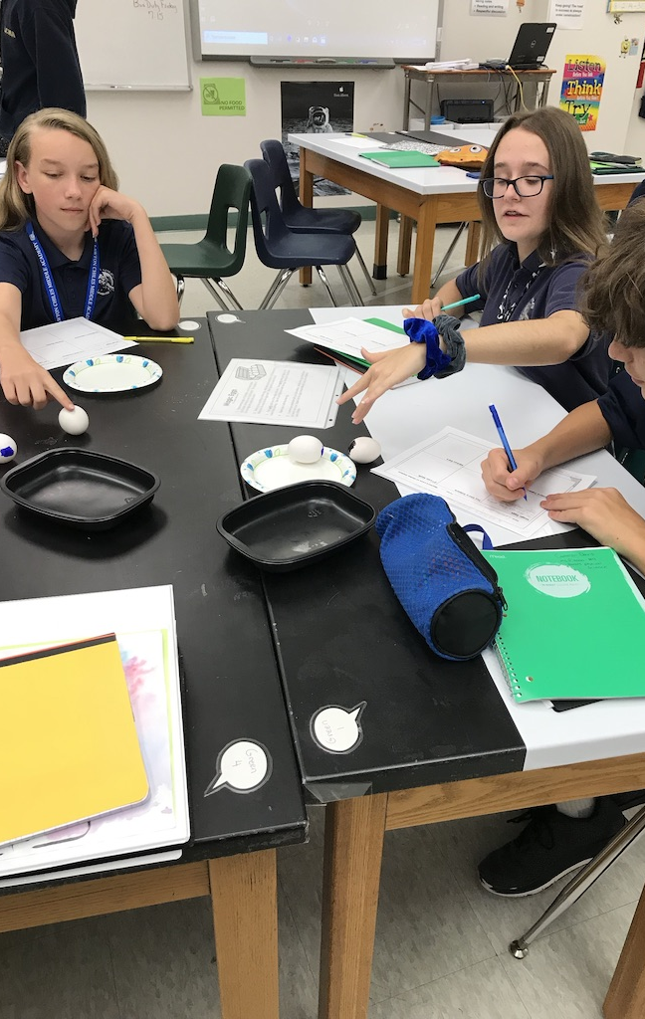
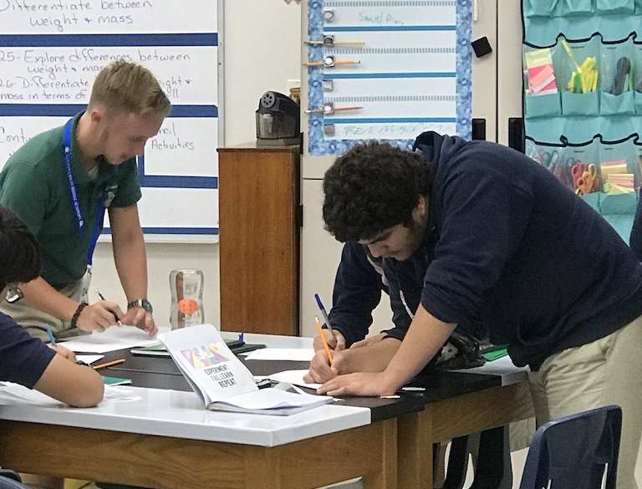
Courses for this year
Accelerated Comprehensive Science 2 Honors
Pre-AP Honors Physical Science

Slide 4
Pre-AP Honors Physical Science
This course introduces students to deeper understandings in Chemistry and Physics.
We begin the year in the chemistry units and work through the physics units during 2nd semester.
Expectations:
Attend class every day and work collaboratively to explore science concepts
Complete one Science Fair Project – this process will begin in August and be complete just after Thanksgiving break.
Maintain a B in the course – as this course applies to your high school GPA, we want to ensure that you earn the highest score possible.
Ask questions! Lots and lots of questions!

Slide 5
Accelerated Comp. Science 2 Honors
This course introduces students to deeper understandings in Chemistry, Space and Life Science.
We begin the year in the Space unit and work through the Life Science unit during 2nd semester.
Expectations:
Attend class every day and work collaboratively to explore science concepts
Complete assignments in Schoology to the best of your ability
Ask questions! Lots and lots of questions!
Complete one Science Fair Project – this process will begin in August and be complete just after Thanksgiving break.

Slide 6
Class Supplies
Daily Student Supplies
1 composition notebook (college ruled) - 1 subject
1 composition (not spiral) (This will remain at home and be used only for science fair data collection)
1 green folder with pockets
1 pack of colored pencils (Class sets are available for student use)
1 pencil (Emergency pencils are available in class)
Optional: Colored pens, highlighters

Slide 7
Parents!
Contact Information
Email: Therese.Gibson@polk-fl.net
Phone: 863-499-2742 ext: 451
How to support your student:
In this very extraordinary time, please closely monitor
student grades through your Parent Portal account.
(https://polkschoolsfl.com/parentportal/)
If you have any questions or concerns, please do not hesitate to contact me, my planning period begins at 1:30pm, I may not be able to respond to your request until that time.

Slide 8
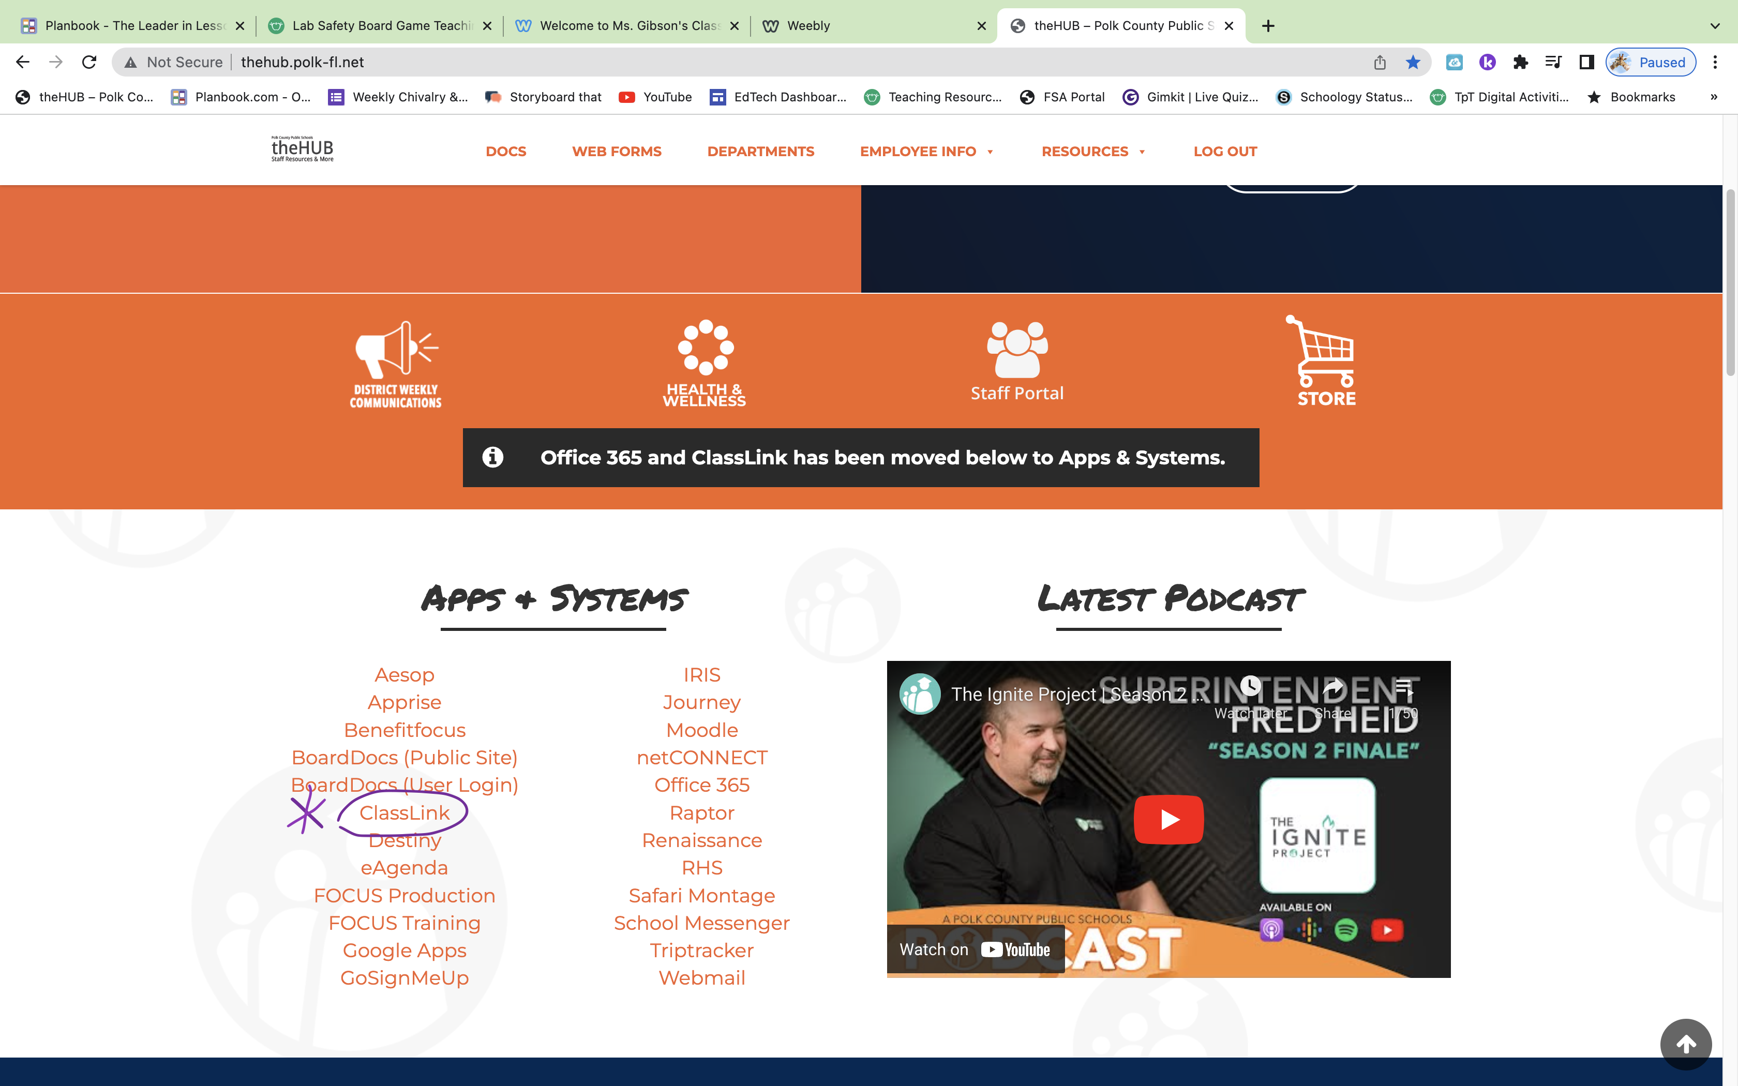
See you soon!
I am very excited to see all of you on Wednesday!

